Slide 1
Middle Avenue and El Camino Real signal and conceptual geometric improvements
December 11, 2024

Slide 2
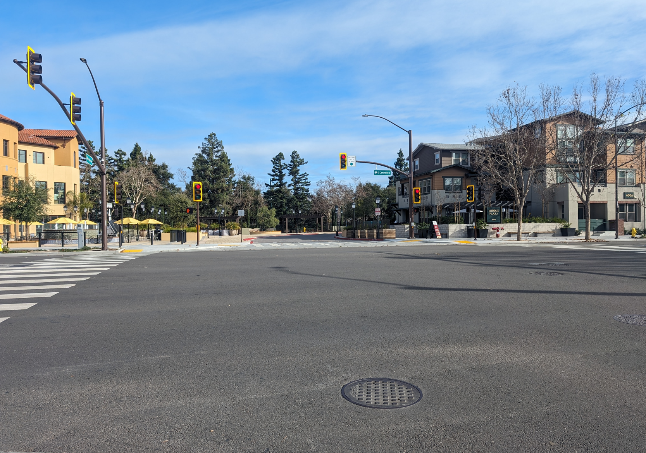
AGENDA
Background
Evaluation
Feedback
Next Steps
Middle Ave. and ECR (view from eastbound Middle Ave.)

Slide 3
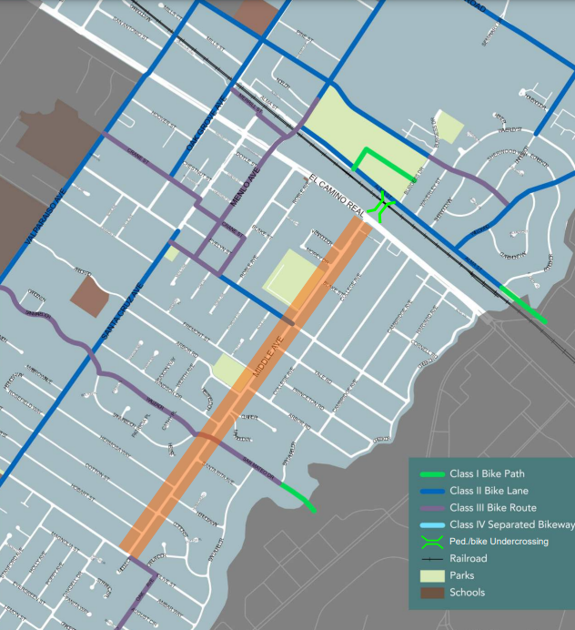
Background (Permanent Improvements)
Mar. 2021: Middle Avenue complete streets project
Oct. 2022: traffic calming measures approved
May 2024: permanent buffered bike lanes approved

Slide 4
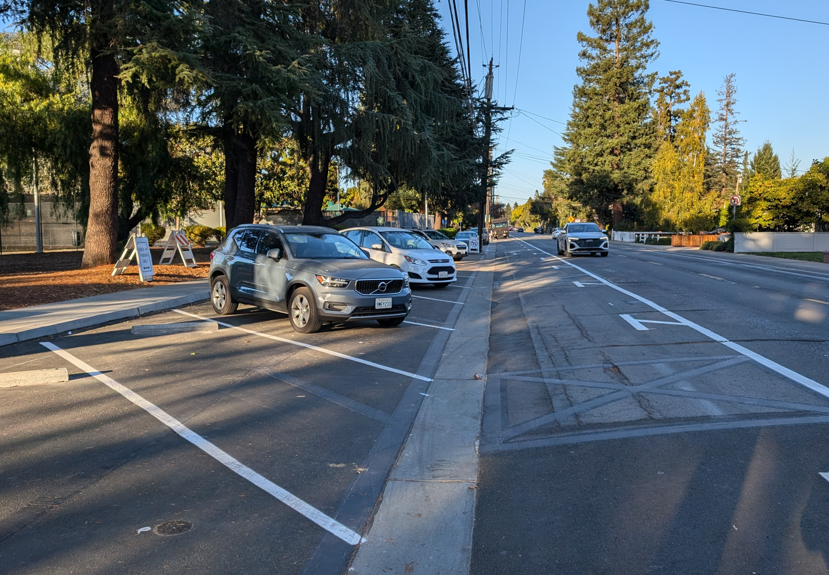
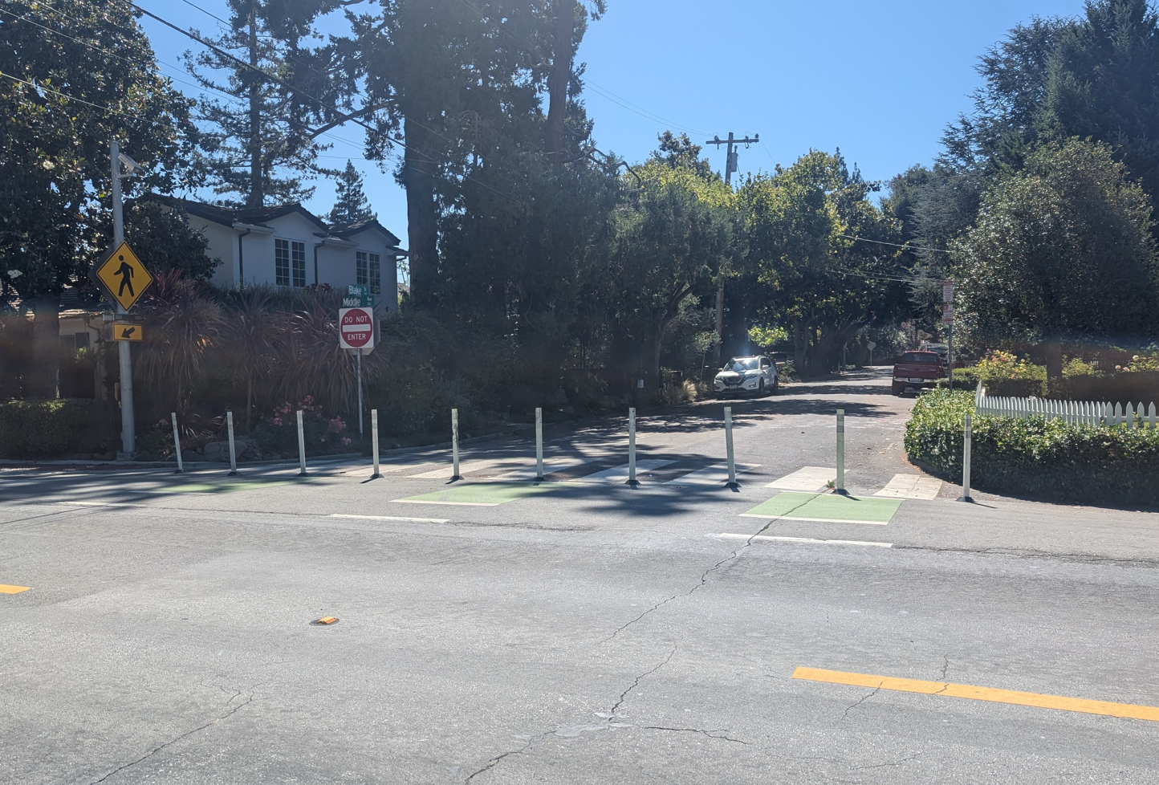
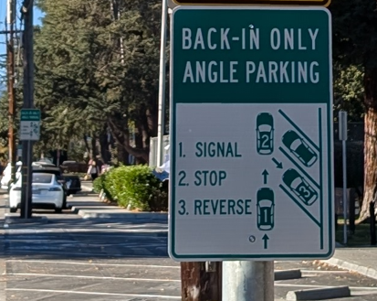
Background (Pilot Projects)
Jan. 2024: Blake St. closure (no access to/from Middle Ave.)
Nov. 2024: Nealon Park frontage parking (back-in angle parking)
Nealon Park frontage parking
(back-in angle parking)
Blake St. closure (no access to/from Middle Ave.)

Slide 5
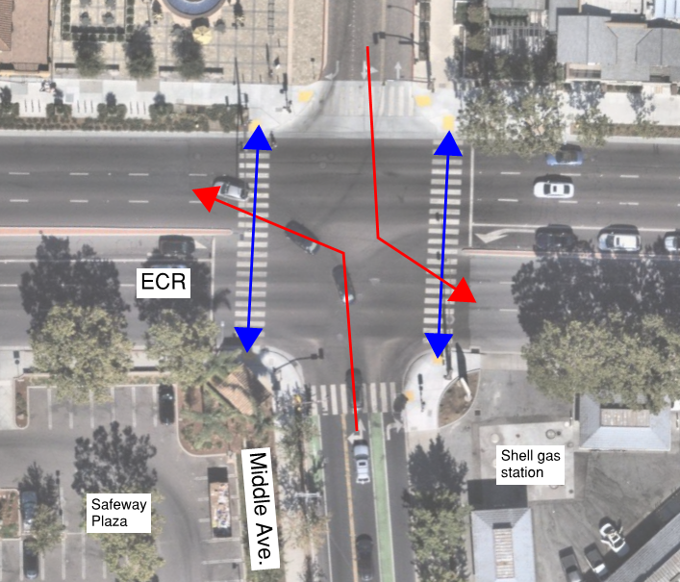
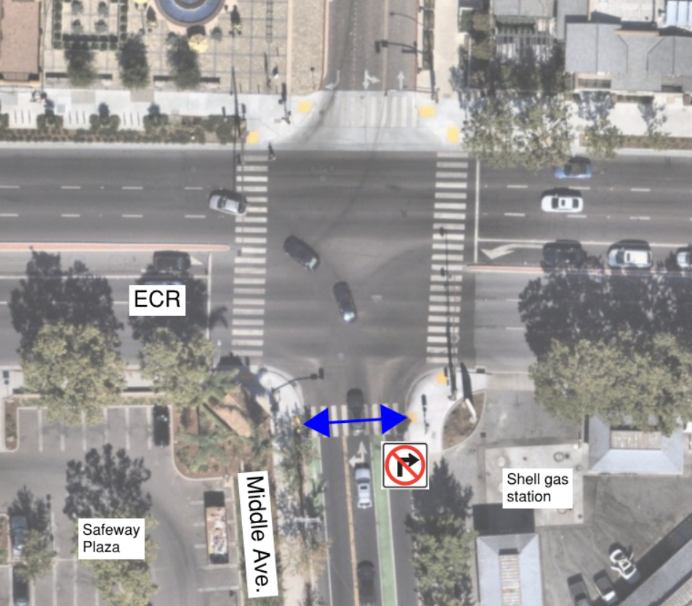
Intersection evaluation (signal Operation)
Remove conflict b/t left turning vehicles from Middle Ave. onto ECR and oncoming traffic/ pedestrians/ bicyclists crossing ECR
Implement no right turn on red (RTOR) from Middle Avenue

Slide 6
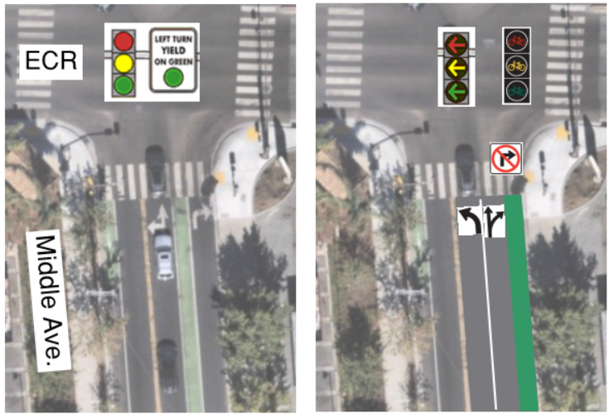
Intersection evaluation (signal Operation)
Alternatives | Lane configuration¹ | Signal phasing²
Existing | LT + R | Permissive
Alt 1 – Existing with no RTOR | LT + R | Permissive
Alt 2 – Protected left with no RTOR | L + TR | Protected
Alt 2A – Protected left with RTOR | L + TR | Protected
Alt 3 – Dedicated bike signal phase | L + TR | Protected
Notes: RTOR = right turn on red LT = shared left & through lane, L = left turn only lane, TR = shared through & right lane, R = right turn only lane. Permissive = left turning vehicles yield to oncoming traffic and crossing pedestrian/bicyclists. Protected = left turning vehicles have no conflict.
Existing
Alternatives

Slide 7
Intersection evaluation (signal Operation)
Alternatives | Lane configuration¹ | Signal phasing² | Key takeaway (compared to existing conditions)
Existing | LT + R | Permissive | Con: left turning vehicles from Middle Ave. conflict with oncoming traffic/ pedestrians/ bicyclists crossing ECR.
Alt 1 – Existing with no RTOR | LT + R | Permissive | Pro: most likely to be approved by Caltrans due to minimal impact to ECR. Con: left turning vehicles from Middle Ave. conflict with oncoming traffic/ pedestrians/ bicyclists crossing ECR. Con: right turn queue on Middle Ave. will worsen.
Alt 2 – Protected left with no RTOR | L + TR | Protected | Pro: resolve left turning vehicles from Middle Ave. conflict with oncoming traffic/ pedestrians/ bicyclists crossing ECR. Con: right turn queue on Middle Ave. will worsen. Con: ECR queue will worsen due to reduced green time.
Alt 2A – Protected left with RTOR | L + TR | Protected | Pro: resolve left turning vehicles from Middle Ave. conflict with oncoming traffic/ pedestrians/ bicyclists crossing ECR. Con: ECR queue will worsen due to reduced green time.
Alt 3 – Dedicated bike signal phase with no RTOR | L + TR | Protected | Pro: resolve left turning vehicles from Middle Ave. conflict with oncoming traffic/ pedestrians/ bicyclists crossing ECR. Pro: dedicated bike phase crossing El Camino Real Con: require more signal time and impact signal coordination. Con: least likely to be approved by Caltrans due to significant impact to ECR. Con: right turn queue on Middle Ave. will worsen.
Notes: RTOR = right turn on red LT = shared left & through lane, L = left turn only lane, TR = shared through & right lane, R = right turn only lane. Permissive = left turning vehicles yield to oncoming traffic and crossing pedestrian/bicyclists. Protected = left turning vehicles have no conflict.

Slide 8
Intersection evaluation (signal Operation)
Approach | Lane storage (ft) | Existing (ft) | Alt 1 – Ex. w/ no RTOR (ft) | Alt 2 – Prot. Left w/ no RTOR (ft) | Alt 2A – Prot. Left w/ RTOR (ft) | Alt 3 – Dedicated bike phase w/ no RTOR (ft)
Northbound Middle Ave.
NBL | 150 turn lane & 980 to Blake St. | 390 (420) | +1,110 (+310) | +880 (+180) | +330 (+0) | +1,110 (+0)
NBT |  |  |  | +30 (+90) | +50 (+20) | +0 (+50)
NBR |  | 340 (290) | +30 (+110)
Southbound Middle Ave.
SBL | 80 turn lane & 250 to garage entrance | 100 (190) | +0 (+0) | -20 (-80) | -30 (-60) | -20 (-70)
SBT |  |  |  | +60 (+110) | +40 (+90) | +50 (+95)
SBR |  | 40 (70) | +0 (+30)
Westbound ECR
WBL | 280 turn lane & 1070 to Cambridge Ave. | 260 (410) | +10 (+0) | +110 (+0) | +60 (+0) | +160 (+0)
WBT |  | 330 (710) | +0 (+100) | +80 (+500) | +0 (+530) | +600 (+660)
Eastbound ECR
EBL | 220 turn lane & 830 to Roble Ave. | 130 (170) | +30 (+10) | +120 (+10) | +90 (+0) | +70 (+0)
EBT |  | 450 (510) | +0 (+0) | +20 (+20) | +70 (+0) | +0 (+0)
Notes: ## (##) = morning (evening) commute hour Results represent the 95 percentile queue length.
Notes:
Mention the approach orientation being different than SR.

Slide 9
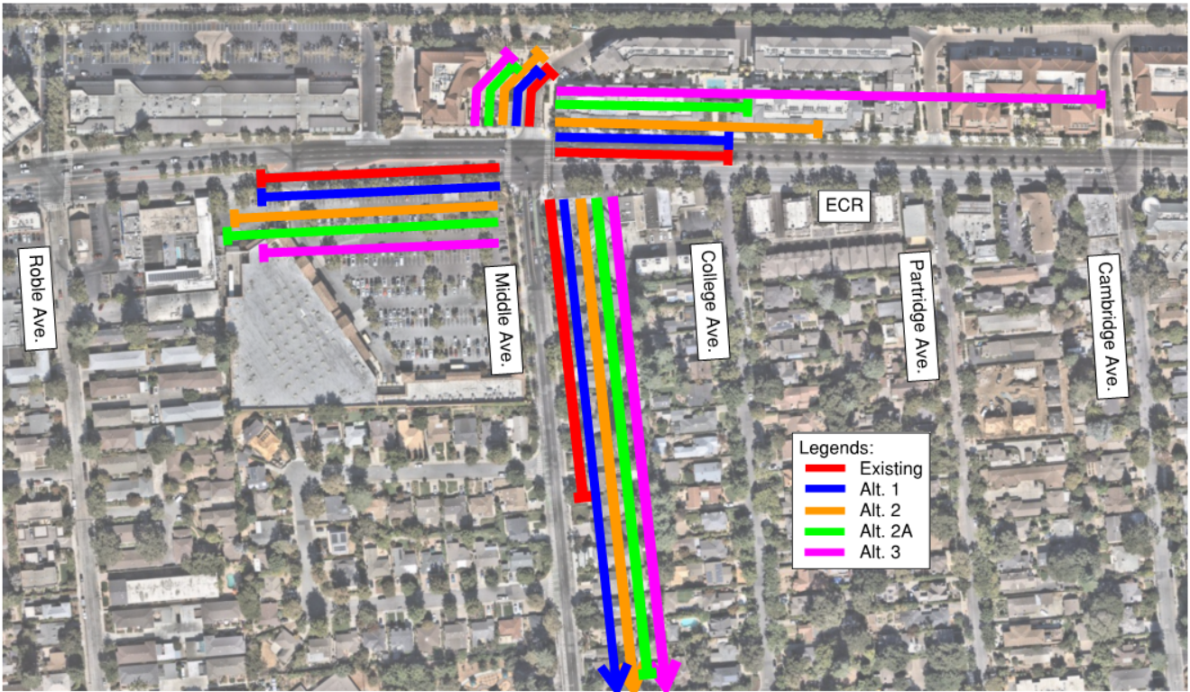
Intersection evaluation (signal Operation – morning commute hour 95% queue)
Notes:
Mention the approach orientation being different than SR.

Slide 10
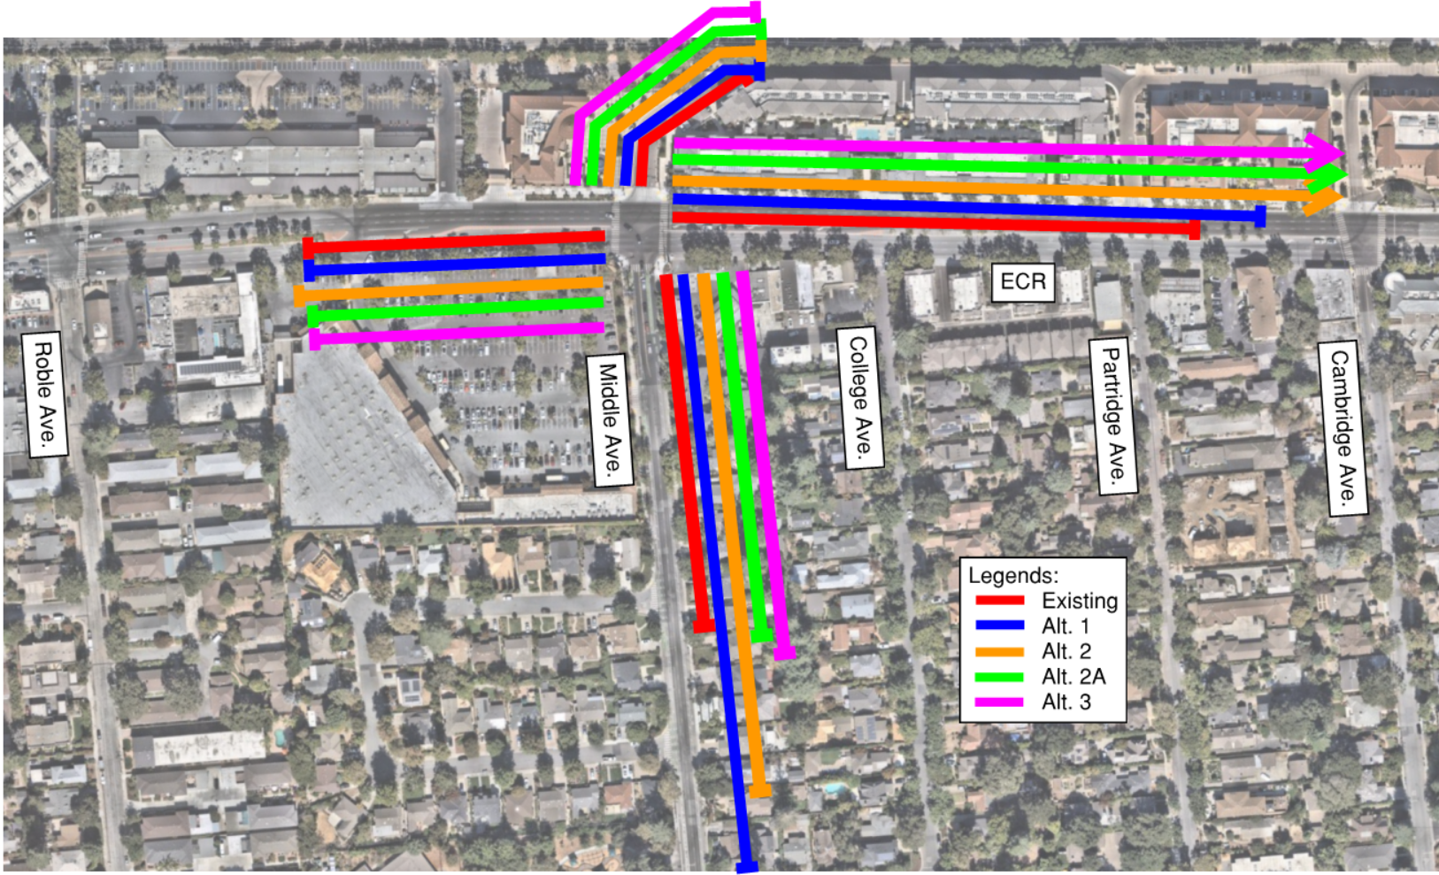
Intersection evaluation (signal Operation – Evening commute hour 95% queue)
Notes:
Mention the approach orientation being different than SR.

Slide 11
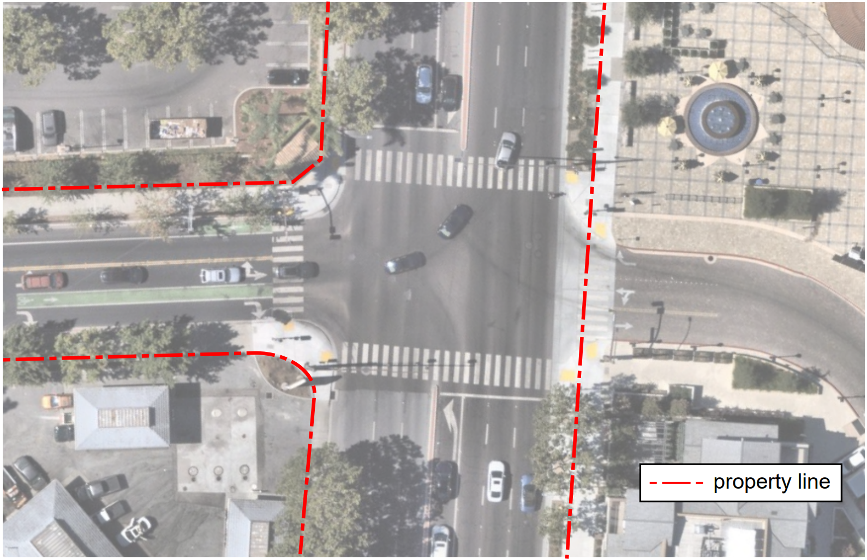
Intersection evaluation (Geometry)
Improve pedestrian/bicycle conditions
ECR
Middle Ave.

Slide 12
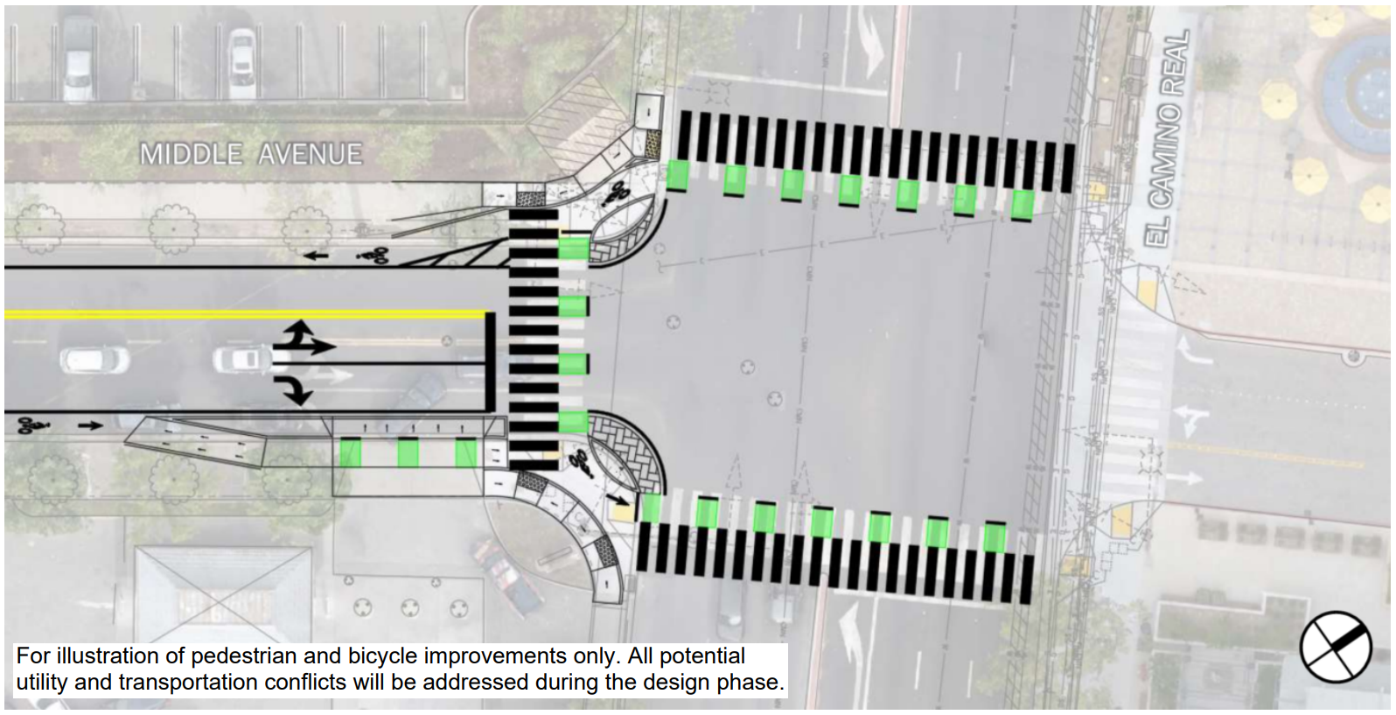
Intersection evaluation (Geometry)
Potential impacts (right of way, utility conflicts, budget & schedule)
ECR
Middle Ave.

Slide 13
Feedback
Signal – which alternative for further analysis?
Geometry – is there consensus to continue or pause design due to constrains (utility relocation, ROW acquisition)?

Slide 14
Next Steps
Incorporate CSC feedback
Present to City Council

Slide 15
Thank you

Slide 16
